Slide 1
Computer & Information Security (372-1-460-1) Introduction
Dept. of Software and Information Systems Engineering, Ben-Gurion University
Prof. Yuval Elovici, Dr. Asaf Shabtai, Dr. Mordechai Guri
Spring, 2019

Slide 2
Syllabus
When:
Monday 09:00 – 12:00
Monday 13:00 – 16:00
Tuesday 09:00 – 12:00
TA’s:
Ron Biton, Ben Nassi, Noam Moskovitch, Avihad Eliyashar, Vitaly Dyadyuk
Exam (70%) + 4 Exercises (30%) + Labs
Should submit 80% of the lab tasks
Reading materials:
Network security: Kaufman/Perlman or Stallings
Web

Slide 3
Syllabus
Introduction to cyber security
Encryption
Access control
Intrusion detection/data leakage/ firewall
Malicious software
Internet security protocols
Attacks: buffer overflow, SQL injection, DoS
Network security

Slide 4
Syllabus

Slide 5
Course goals
Understanding threats to today’s computerized world
Introduction to standard and emerging security mechanisms
Setting a security state of mind
Hands on experience

Slide 6
Course positioning
Introduction to computer and network security
Cryptography
Information Security Management
Malware Internals
סוגיות מתקדמות בקוד עוין
הנדסת אבטחת מערכות
Operating Systems Security
Cyber Security Using Machine Learning
Network Security
Implementation Attacks
Advanced topics in security

Slide 7
Ethics
You will learn and practice attack techniques and approaches that can cause real damage
Do not ‘experiment’ without guidance

Slide 8
Computer & information security
What is computer/network/ information security?

Slide 9
Cyber security
Cyber security is defined as the intersection of
computer security
network security
information security
and…
physical space
Notes:
Estonia (Wikipedia): Cyberattacks on Estonia refers to a series of cyber attacks that began 27 April 2007 and swamped websites of Estonian organizations, including Estonian parliament, banks, ministries, newspapers and broadcasters, amid the country's row with Russia about the relocation of the Bronze Soldier of Tallinn, an elaborate Soviet-era grave marker, as well as war graves in Tallinn. Most of the attacks that had any influence on the general public were distributed denial of service type attacks ranging from single individuals using various methods like ping floods to expensive rentals of botnets usually used for spam distribution. Spamming of bigger news portals commentaries and defacements including that of the Estonian Reform Party website also occurred.
GHOSTNET (Wikipedia): the name given by researchers at the Information Warfare Monitor to a large-scale cyber spying operation discovered in March 2009. The operation is likely associated with an Advanced Persistent Threat. Its command and control infrastructure is based mainly in the People's Republic of China and has infiltrated high-value political, economic and media locations in 103 countries. Computer systems belonging to embassies, foreign ministries and other government offices, and the Dalai Lama's Tibetan exile centers in India, London and New York City were compromised. Although the activity is mostly based in China, there is no conclusive evidence that the Chinese government is involved in its operation.
Operation Aurora (Wikipedia): Operation Aurora was a cyber attack which began in mid-2009 and continued through December 2009. The attack was first publicly disclosed by Google on January 12, 2010, in a blog post. In the blog post, Google said the attack originated in China. The attacks were both sophisticated and well resourced and consistent with an advanced persistent threat attack.
The attack has been aimed at dozens of other organizations, of which Adobe Systems, Juniper Networks and Rackspace have publicly confirmed that they were targeted. According to media reports, Yahoo, Symantec, Northrop Grumman, Morgan Stanley and Dow Chemical were also among the targets. As a result of the attack, Google stated in its blog that it plans to operate a completely uncensored version of its search engine in China "within the law, if at all", and acknowledged that if this is not possible it may leave China and close its Chinese offices. Official Chinese media responded stating that the incident is part of a U.S. government conspiracy.
The attack was named "Operation Aurora" by Dmitri Alperovitch, Vice President of Threat Research at cyber security company McAfee. Research by McAfee Labs discovered that “Aurora” was part of the file path on the attacker’s machine that was included in two of the malware binaries McAfee said were associated with the attack. "We believe the name was the internal name the attacker(s) gave to this operation," McAfee Chief Technology Officer George Kurtz said in a blog post.
According to McAfee, the primary goal of the attack was to gain access to and potentially modify source code repositories at these high tech, security and defense contractor companies. “[The SCMs] were wide open,” says Alperovitch. “No one ever thought about securing them, yet these were the crown jewels of most of these companies in many ways — much more valuable than any financial or personally identifiable data that they may have and spend so much time and effort protecting.“
NASDAQ: NASDQ Web site was attacked DoS. Not the trading systems.
Sony: “The theft comes on top of the 77 million PlayStation accounts taken in a cyber attack.”
The names, addresses, emails, birth dates, phone numbers and other information for 24.6m PC games customers were stolen from its servers.
Sony also said the financial records of users from an outdated 2007 database involving people outside the US may have been stolen, including 10,700 direct debit records of customers in Austria, Germany, the Netherlands and Spain.
Lockheed Martin: “Hackers reportedly exploited Lockheed's VPN access system, which allows employees to log in remotely by using their RSA SecurID hardware tokens. Attackers apparently possessed the seeds--factory-encoded random keys--used by at least some of Lockheed's SecurID hardware fobs, as well as serial numbers and the underlying algorithm used to secure the devices.
That suggests that whoever attacked Lockheed Martin may also have been behind the successful breach in March of EMC's RSA division, which manufactures SecurID. "Since then, there have been malware and phishing campaigns in the wild seeking specific data linking RSA tokens to the end user, leading us to believe that this attack was carried out by the original RSA attackers," Rick Moy, president and CEO of NSS Labs, said in a blog post.
Banks: Denial of Service
FLAME: discovered in 2012 that attacks computers running the Microsoft Windows operating system. The program is being used for targeted cyber espionage in Middle Eastern countries. Its discovery was announced on 28 May 2012 by MAHER Center of Iranian National Computer Emergency Response Team (CERT), Kaspersky Lab and CrySyS Lab of the Budapest University of Technology and Economics. The last of these stated in its report that it "is certainly the most sophisticated malware we encountered during our practice; arguably, it is the most complex malware ever found."
Flame can spread to other systems over a local network (LAN) or via USB stick. It can record audio, screenshots, keyboard activity and network traffic. The program also records Skype conversations and can turn infected computers into Bluetooth beacons which attempt to download contact information from nearby Bluetooth-enabled devices. This data, along with locally stored documents, is sent on to one of several command and control servers that are scattered around the world. The program then awaits further instructions from these servers.
According to estimates by Kaspersky in May 2012, Flame had initially infected approximately 1,000 machines, with victims including governmental organizations, educational institutions and private individuals. At that time 65% of the infections happened in Iran, Israel, Sudan, Syria, Lebanon, Saudi Arabia, and Egypt, with a "huge majority of targets" within Iran. Flame has also been reported in Europe and North America. Flame supports a "kill" command which wipes all traces of the malware from the computer. The initial infections of Flame stopped operating after its public exposure, and the "kill" command was sent.

Slide 10
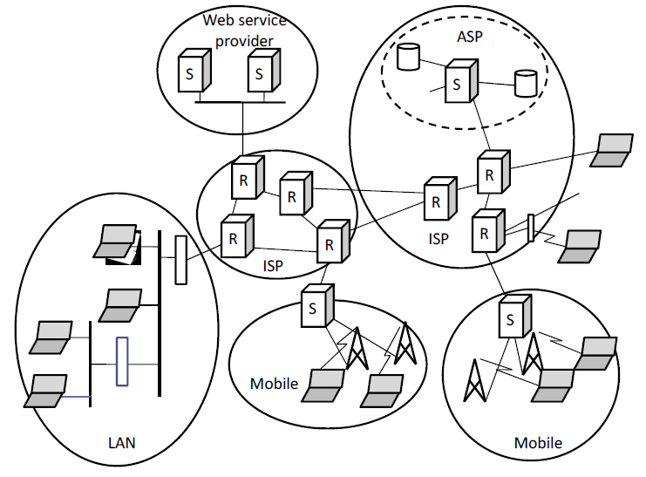
Everything is connected…

Slide 11

Everything is connected…

Slide 12
Everything is connected…
Internet is global, open, everybody online…
Including the attackers!
Computers are unprotected, unmanaged
Insecure platforms (Windows, IE, pdf readers)
Naïve users
Many, untrusted clients and peers
Protocols designed for friendly/secure environment
Many threats / attacks…

Slide 13
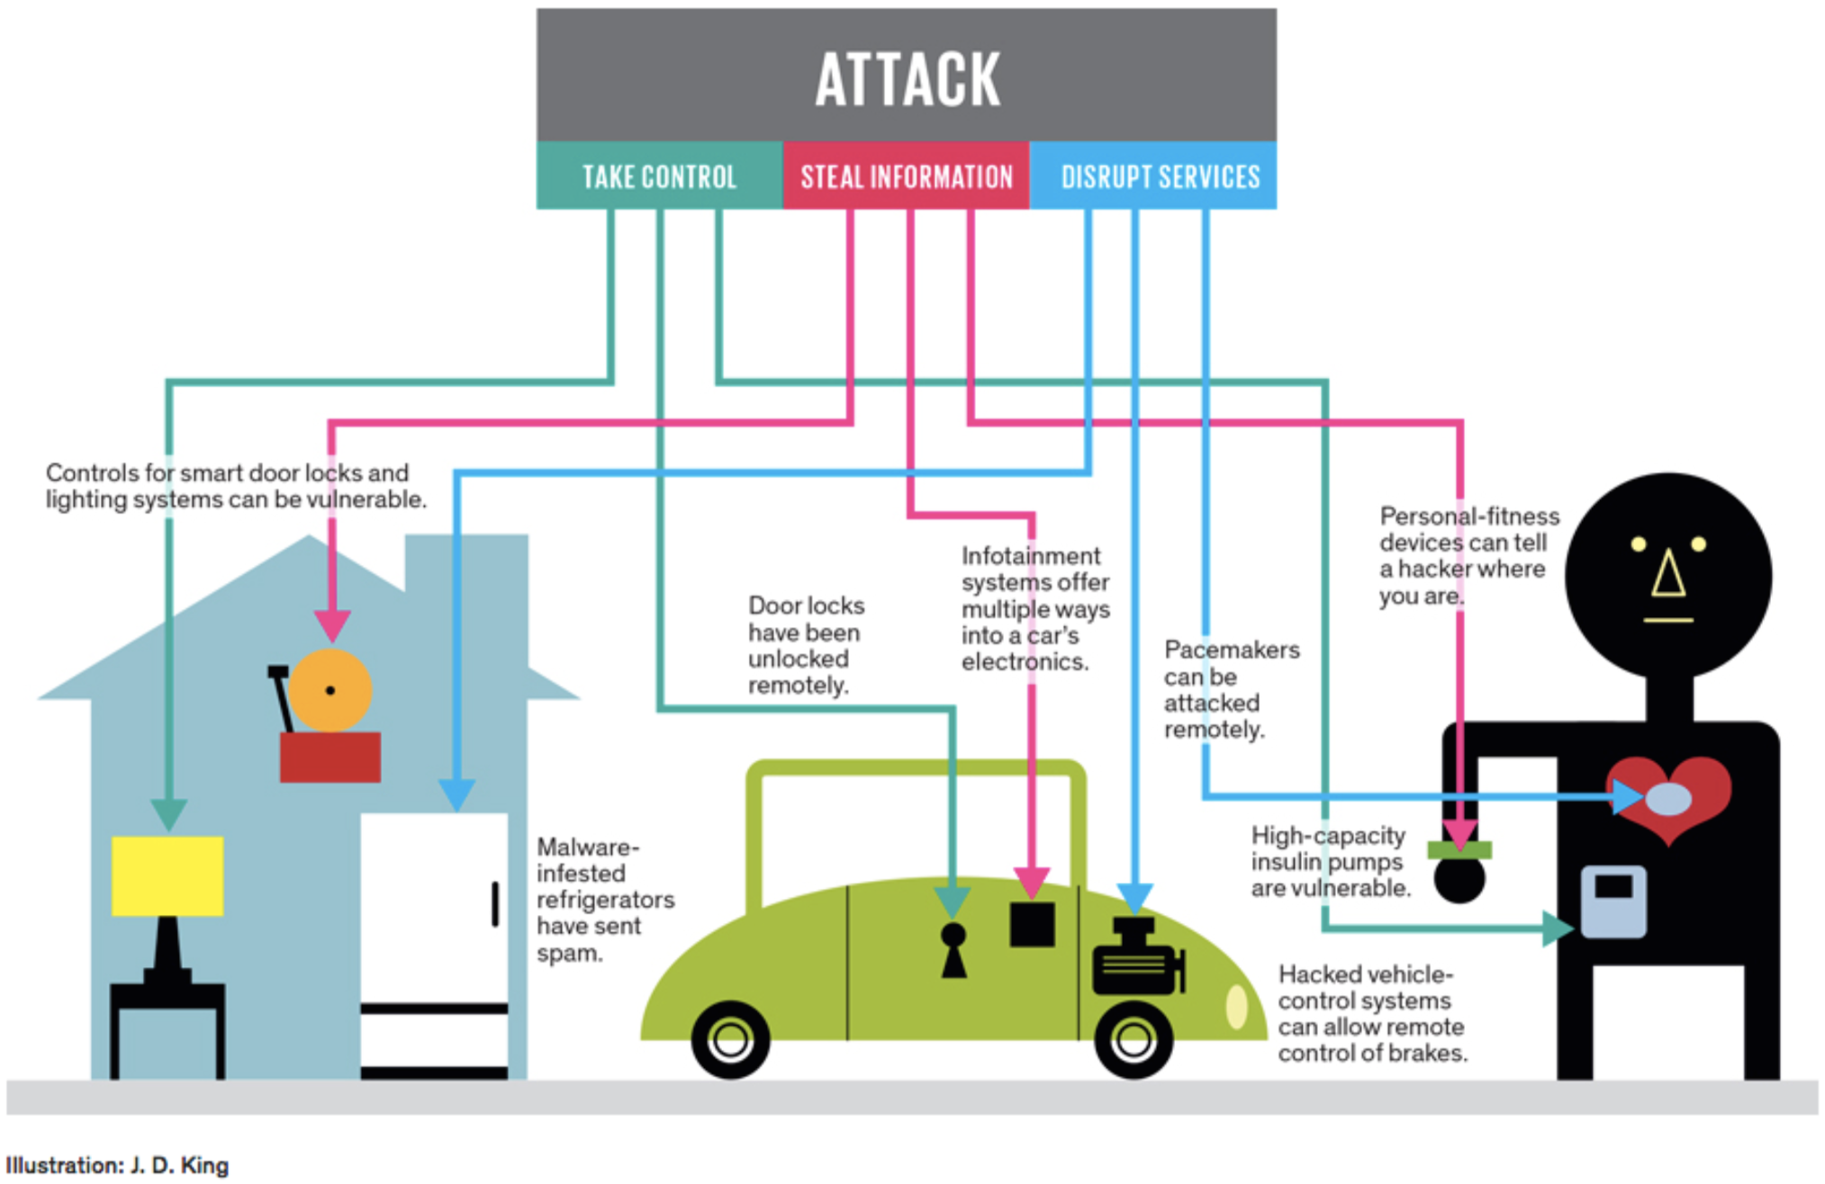

Slide 14
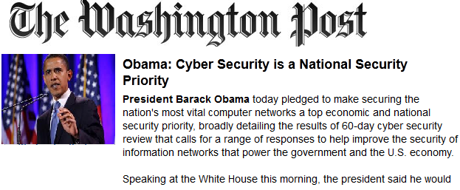
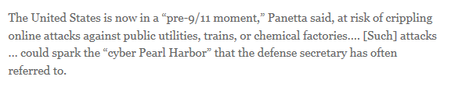
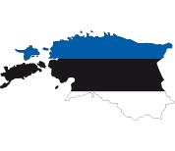

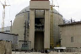





What are the threats…
2009 OPERATION AURORA
2010 NASDAQ
2010 STUXNET
2011 SONY
2011 LOCKHEED MARTIN
2008 GHOSTNET
2007 ESTONIA
2012 FLAME
2012
US BANKS
Notes:
Estonia (Wikipedia): Cyberattacks on Estonia refers to a series of cyber attacks that began 27 April 2007 and swamped websites of Estonian organizations, including Estonian parliament, banks, ministries, newspapers and broadcasters, amid the country's row with Russia about the relocation of the Bronze Soldier of Tallinn, an elaborate Soviet-era grave marker, as well as war graves in Tallinn. Most of the attacks that had any influence on the general public were distributed denial of service type attacks ranging from single individuals using various methods like ping floods to expensive rentals of botnets usually used for spam distribution. Spamming of bigger news portals commentaries and defacements including that of the Estonian Reform Party website also occurred.
GHOSTNET (Wikipedia): the name given by researchers at the Information Warfare Monitor to a large-scale cyber spying operation discovered in March 2009. The operation is likely associated with an Advanced Persistent Threat. Its command and control infrastructure is based mainly in the People's Republic of China and has infiltrated high-value political, economic and media locations in 103 countries. Computer systems belonging to embassies, foreign ministries and other government offices, and the Dalai Lama's Tibetan exile centers in India, London and New York City were compromised. Although the activity is mostly based in China, there is no conclusive evidence that the Chinese government is involved in its operation.
Operation Aurora (Wikipedia): Operation Aurora was a cyber attack which began in mid-2009 and continued through December 2009. The attack was first publicly disclosed by Google on January 12, 2010, in a blog post. In the blog post, Google said the attack originated in China. The attacks were both sophisticated and well resourced and consistent with an advanced persistent threat attack.
The attack has been aimed at dozens of other organizations, of which Adobe Systems, Juniper Networks and Rackspace have publicly confirmed that they were targeted. According to media reports, Yahoo, Symantec, Northrop Grumman, Morgan Stanley and Dow Chemical were also among the targets. As a result of the attack, Google stated in its blog that it plans to operate a completely uncensored version of its search engine in China "within the law, if at all", and acknowledged that if this is not possible it may leave China and close its Chinese offices. Official Chinese media responded stating that the incident is part of a U.S. government conspiracy.
The attack was named "Operation Aurora" by Dmitri Alperovitch, Vice President of Threat Research at cyber security company McAfee. Research by McAfee Labs discovered that “Aurora” was part of the file path on the attacker’s machine that was included in two of the malware binaries McAfee said were associated with the attack. "We believe the name was the internal name the attacker(s) gave to this operation," McAfee Chief Technology Officer George Kurtz said in a blog post.
According to McAfee, the primary goal of the attack was to gain access to and potentially modify source code repositories at these high tech, security and defense contractor companies. “[The SCMs] were wide open,” says Alperovitch. “No one ever thought about securing them, yet these were the crown jewels of most of these companies in many ways — much more valuable than any financial or personally identifiable data that they may have and spend so much time and effort protecting.“
NASDAQ: NASDQ Web site was attacked DoS. Not the trading systems.
Sony: “The theft comes on top of the 77 million PlayStation accounts taken in a cyber attack.”
The names, addresses, emails, birth dates, phone numbers and other information for 24.6m PC games customers were stolen from its servers.
Sony also said the financial records of users from an outdated 2007 database involving people outside the US may have been stolen, including 10,700 direct debit records of customers in Austria, Germany, the Netherlands and Spain.
Lockheed Martin: “Hackers reportedly exploited Lockheed's VPN access system, which allows employees to log in remotely by using their RSA SecurID hardware tokens. Attackers apparently possessed the seeds--factory-encoded random keys--used by at least some of Lockheed's SecurID hardware fobs, as well as serial numbers and the underlying algorithm used to secure the devices.
That suggests that whoever attacked Lockheed Martin may also have been behind the successful breach in March of EMC's RSA division, which manufactures SecurID. "Since then, there have been malware and phishing campaigns in the wild seeking specific data linking RSA tokens to the end user, leading us to believe that this attack was carried out by the original RSA attackers," Rick Moy, president and CEO of NSS Labs, said in a blog post.
Banks: Denial of Service
FLAME: discovered in 2012 that attacks computers running the Microsoft Windows operating system. The program is being used for targeted cyber espionage in Middle Eastern countries. Its discovery was announced on 28 May 2012 by MAHER Center of Iranian National Computer Emergency Response Team (CERT), Kaspersky Lab and CrySyS Lab of the Budapest University of Technology and Economics. The last of these stated in its report that it "is certainly the most sophisticated malware we encountered during our practice; arguably, it is the most complex malware ever found."
Flame can spread to other systems over a local network (LAN) or via USB stick. It can record audio, screenshots, keyboard activity and network traffic. The program also records Skype conversations and can turn infected computers into Bluetooth beacons which attempt to download contact information from nearby Bluetooth-enabled devices. This data, along with locally stored documents, is sent on to one of several command and control servers that are scattered around the world. The program then awaits further instructions from these servers.
According to estimates by Kaspersky in May 2012, Flame had initially infected approximately 1,000 machines, with victims including governmental organizations, educational institutions and private individuals. At that time 65% of the infections happened in Iran, Israel, Sudan, Syria, Lebanon, Saudi Arabia, and Egypt, with a "huge majority of targets" within Iran. Flame has also been reported in Europe and North America. Flame supports a "kill" command which wipes all traces of the malware from the computer. The initial infections of Flame stopped operating after its public exposure, and the "kill" command was sent.

Slide 15
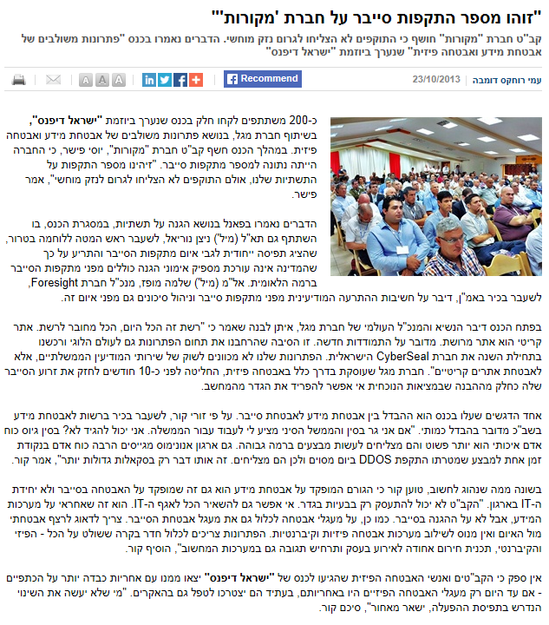
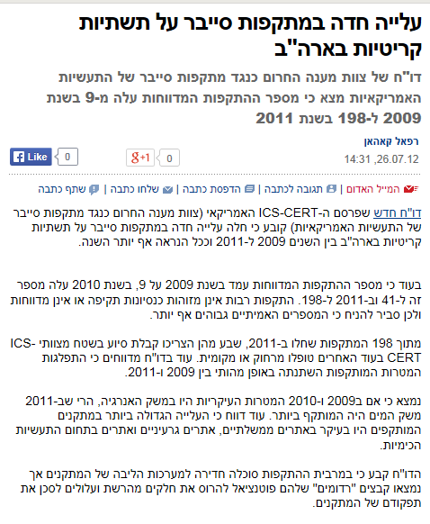
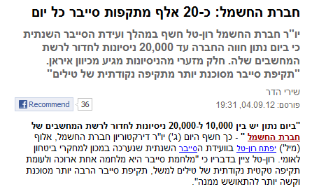
Some more examples…

Slide 16
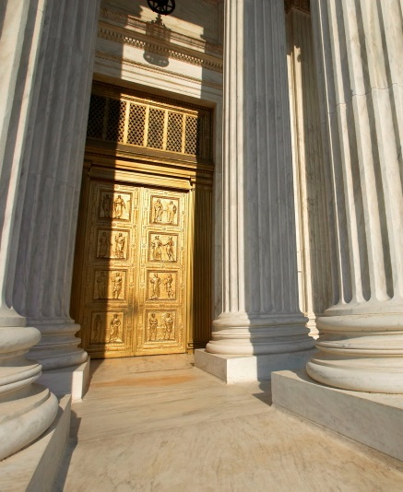


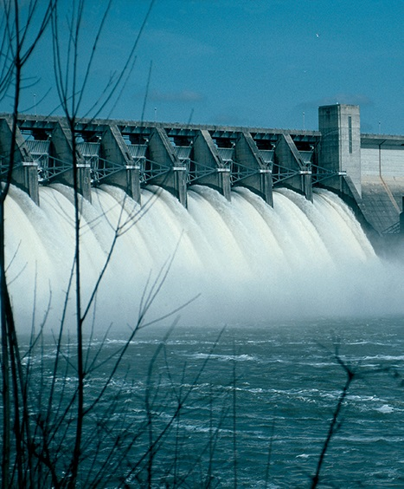
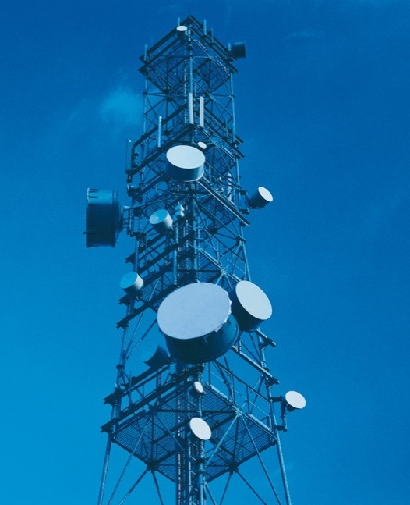

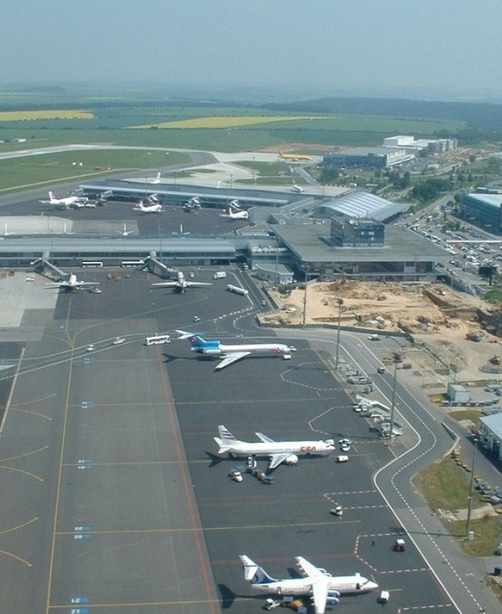

Cyber attacks and critical infrastructure
Government Operations
Emergency Systems
Gas & Oil
Water Supply Systems
Critical Infrastructures
Telecommunications
Electrical Energy
Transportation
Banking & Finance

Slide 17
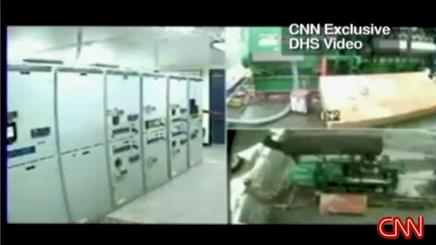
Project ‘Aurora’ (2007)
Notes:
A U.S. Department of Homeland Security exercise codenamed 'Aurora‘
Conducted in March 2007
Researchers were able to cause a power generator to self-destruct remotely via a hack which changed the operating cycle of the generator

Slide 18
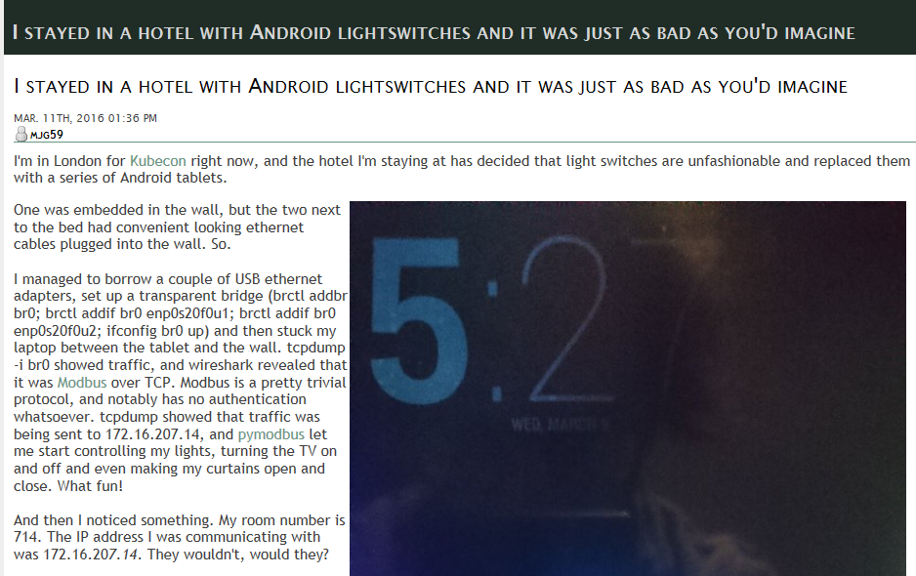
SCADA Networks

Slide 19
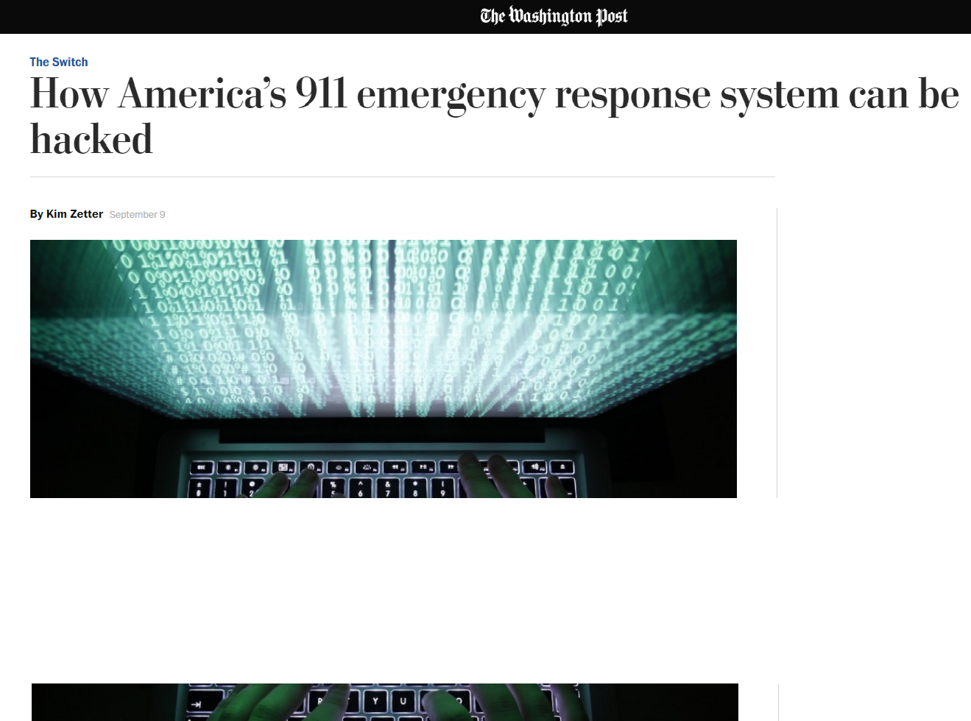
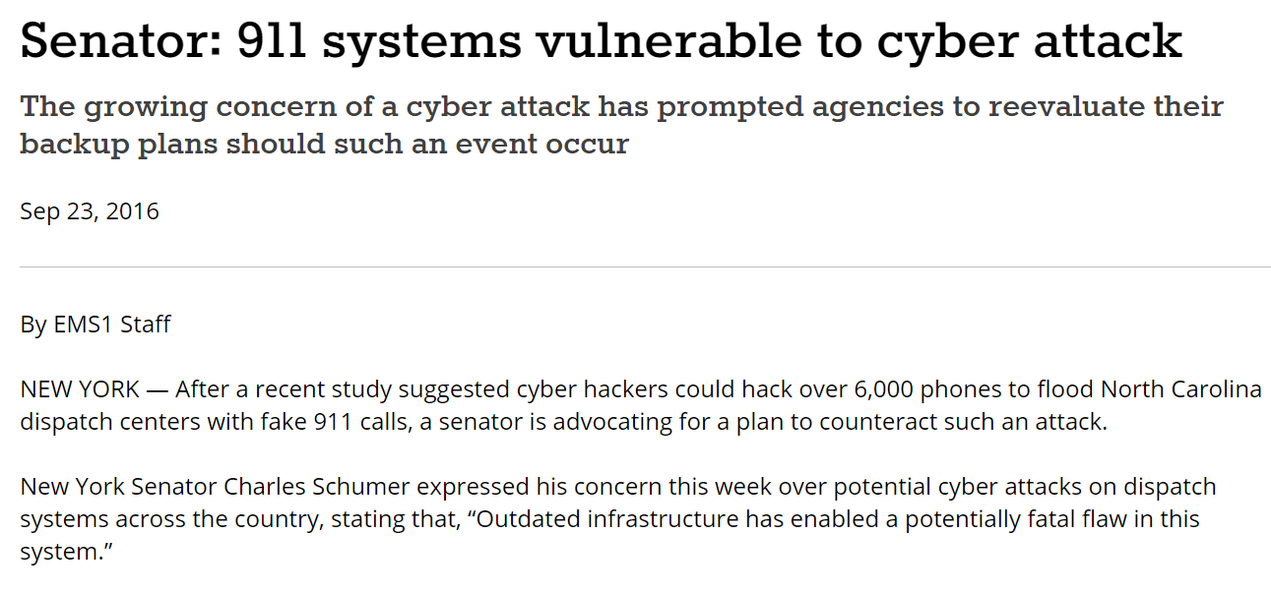
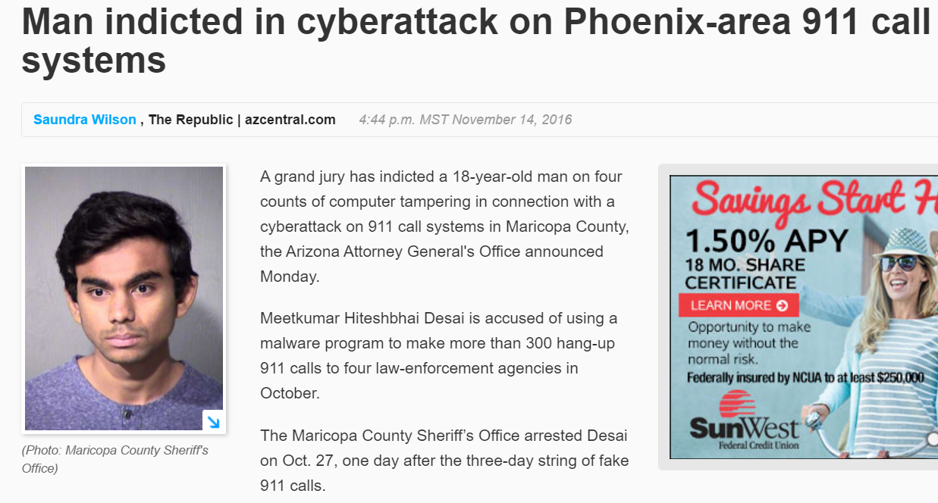
9-1-1 system DDoS blackout

Slide 20
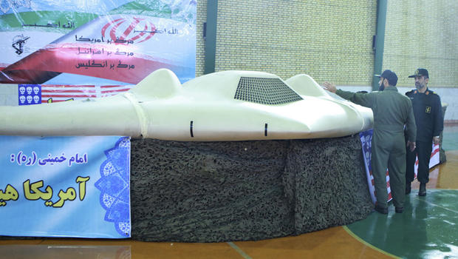
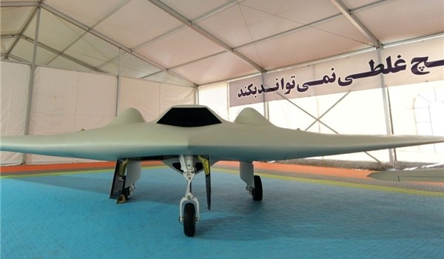
Find the difference…
USAF RQ-170

Slide 21
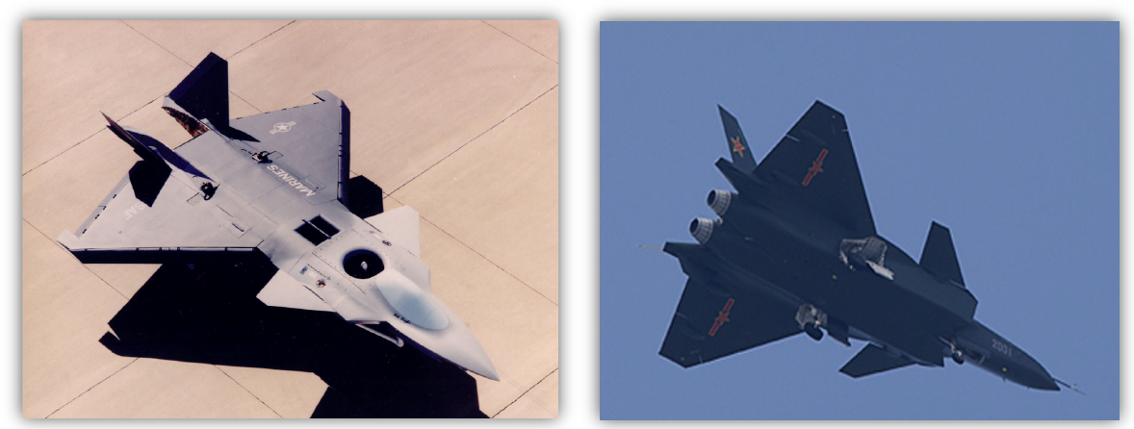
Find the difference…
United States F-22 vs. China J-20

Slide 22
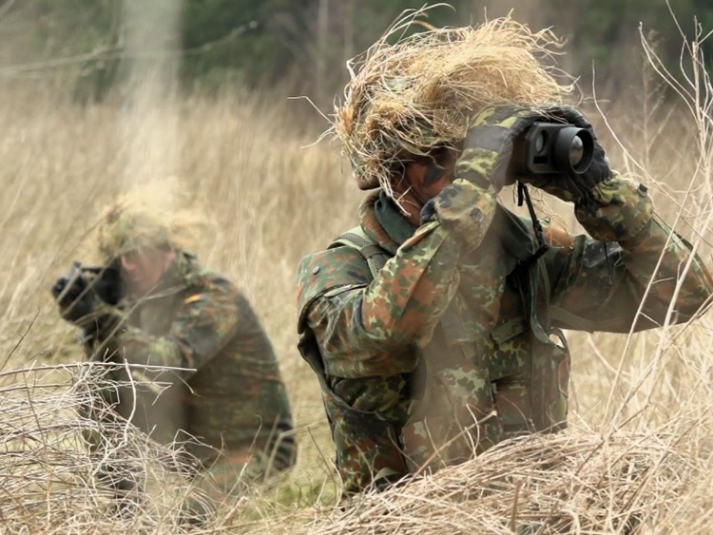
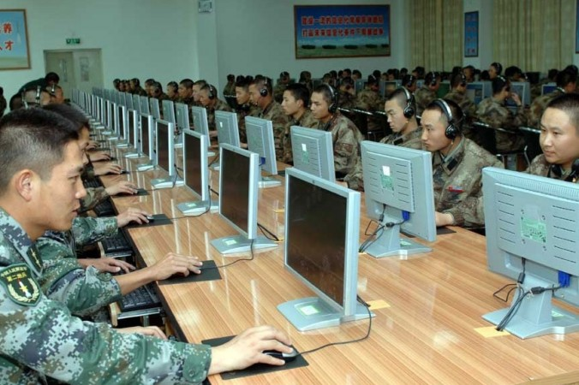

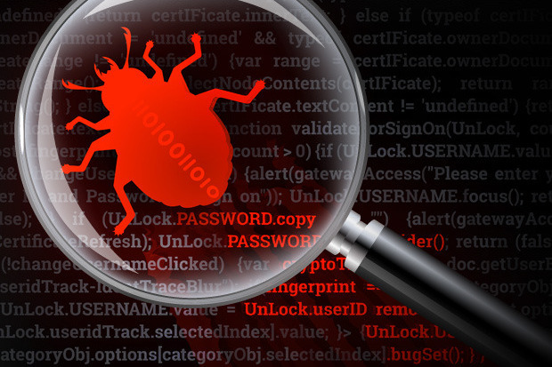
Today’s battlefield

Slide 23
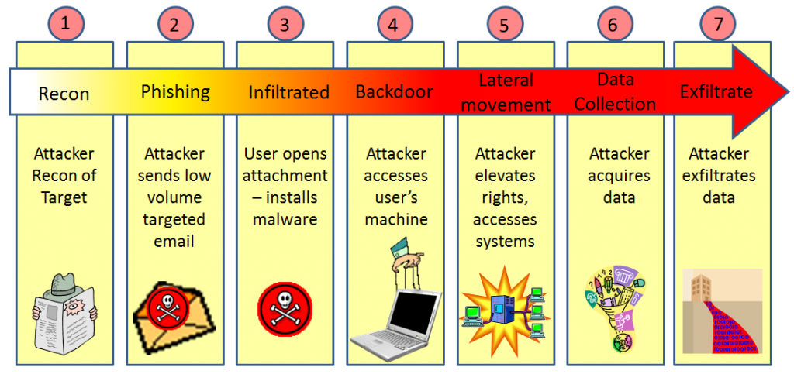
Advanced persistence threat (APT)
A cyber attack mounted by organizational teams (e.g., foreign government) that have deep resources, advanced penetration skills, specific target profiles (political or commercial) and are remarkably persistent in their efforts

Slide 24
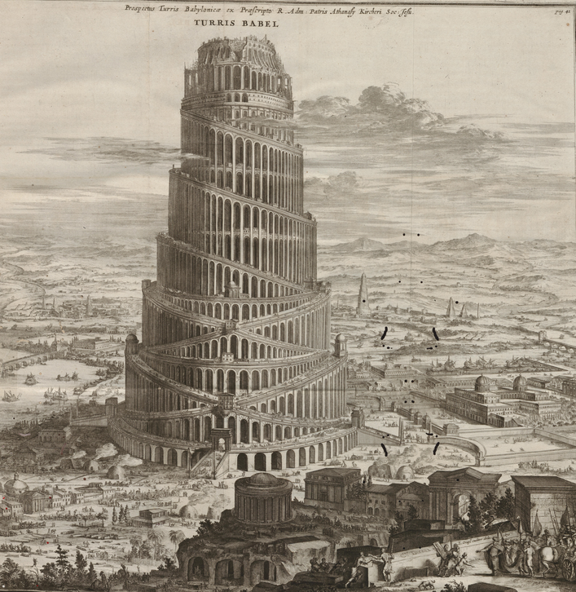
An Observation from the Bible
“if as one people speaking the same language they have begun to do this, then nothing they plan to do will be impossible for them"
The fact that many computers are based on the same operating system allows the attackers to design successful attacks that can also propagate from one computer to another.

Slide 25
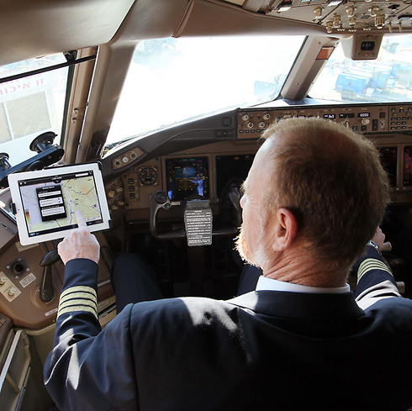
What’s wrong with that picture?

Slide 26
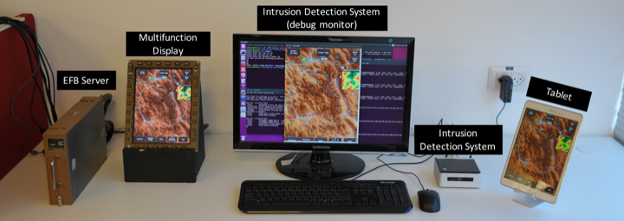
Evaluation Testbed (PoC)

Slide 27
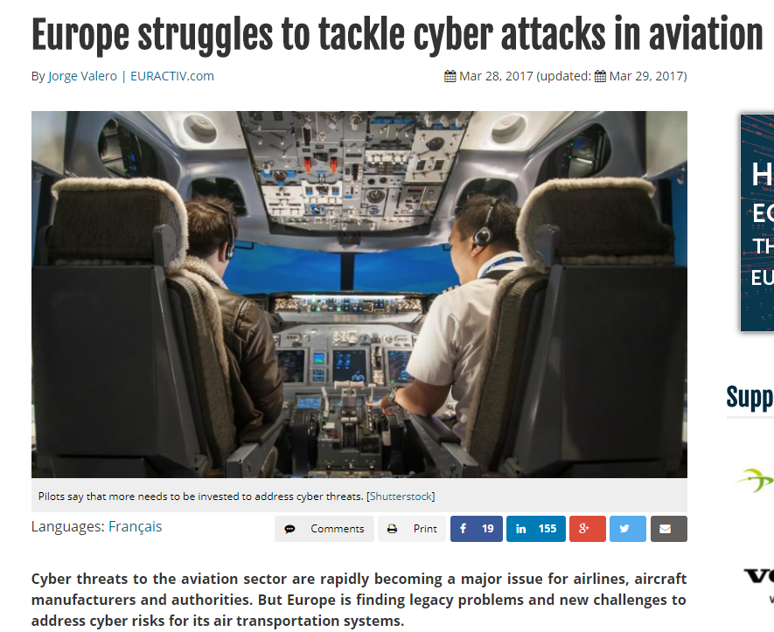
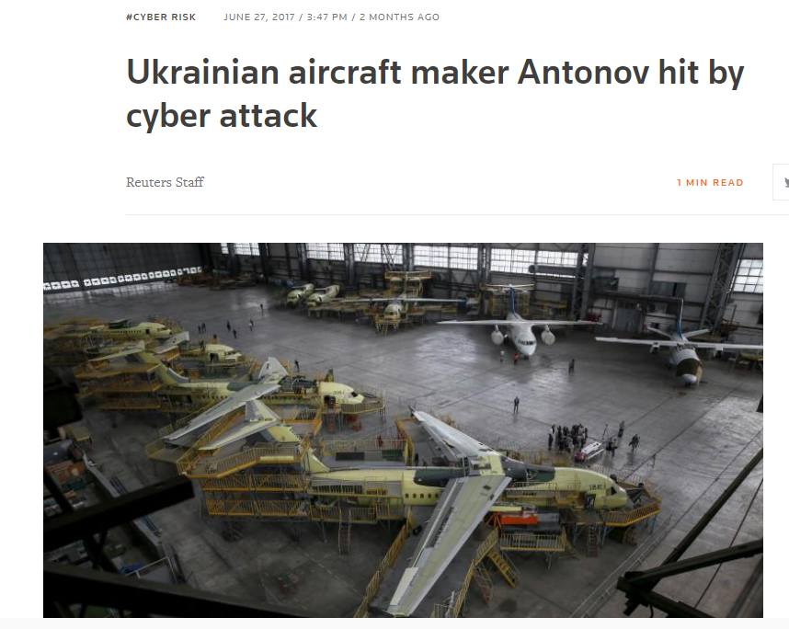
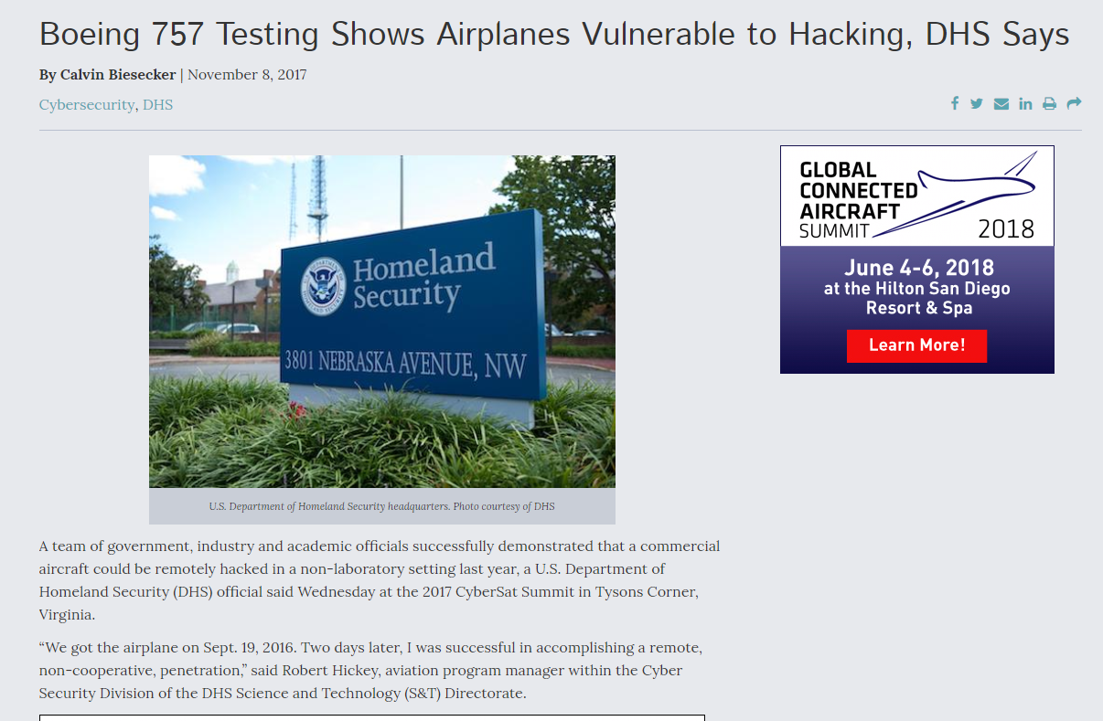
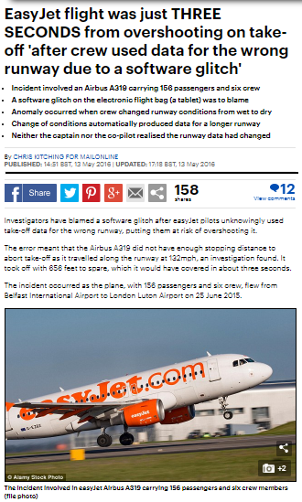
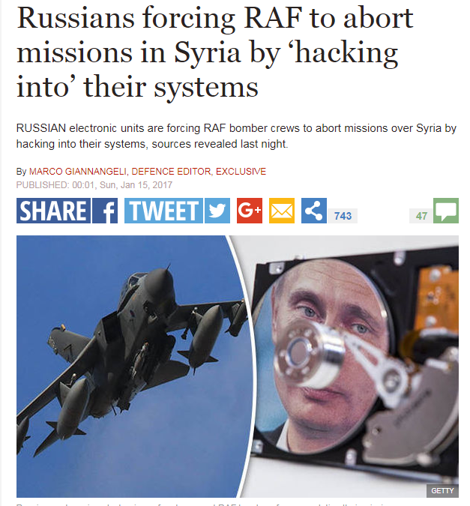
Attacks on avionic systems – becoming a real threat…

Slide 28
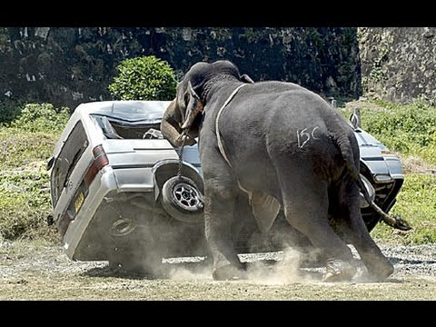
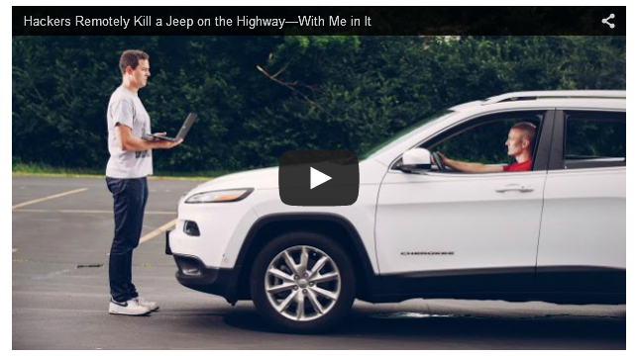
Attacks on cars

Slide 29
Automobile Example
The Tesla Hack @ Black Hat 2016 & 2017
Keen Security Lab: turn on the brakes remotely and getting the doors and trunk to open and close while blinking the lights in time to music streamed from the car's radio on Tesla Model X.
“the work was complex and not easily replicated”
The Jeep Hack @ Black Hat 2015 & 2016
Remotely stop a car and disable its brake.
Plug into the car's electronic system to hijack its steering and brake systems
The TPMS “Hack”
Tire Pressure Monitoring System (TPMS) signal sent wirelessly
Easily eavesdropped, with unique identifier

Slide 30

Autonomous cars

Slide 31
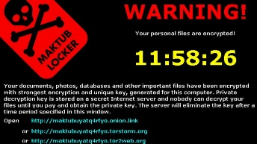
Autonomous cars

Slide 32
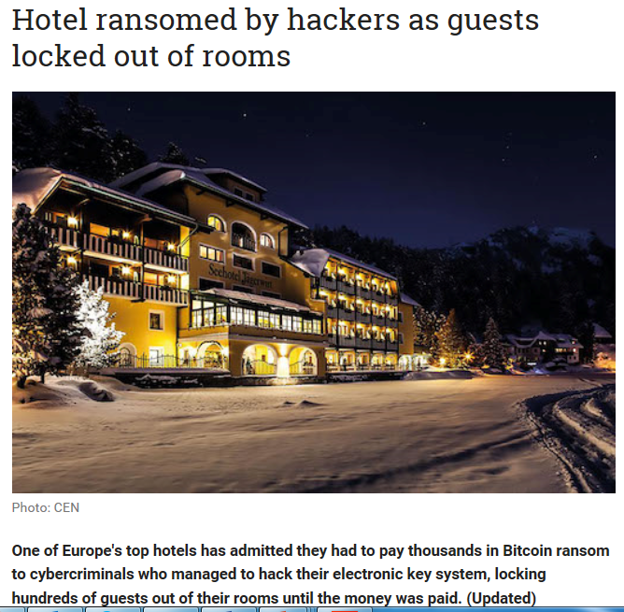

Slide 33
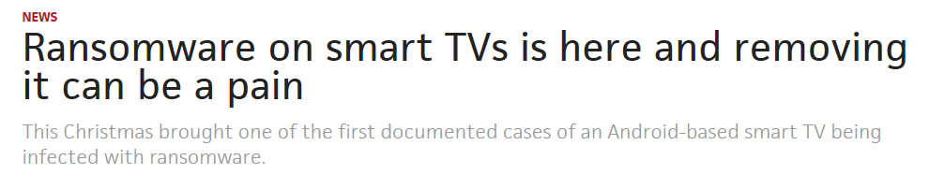

Slide 34
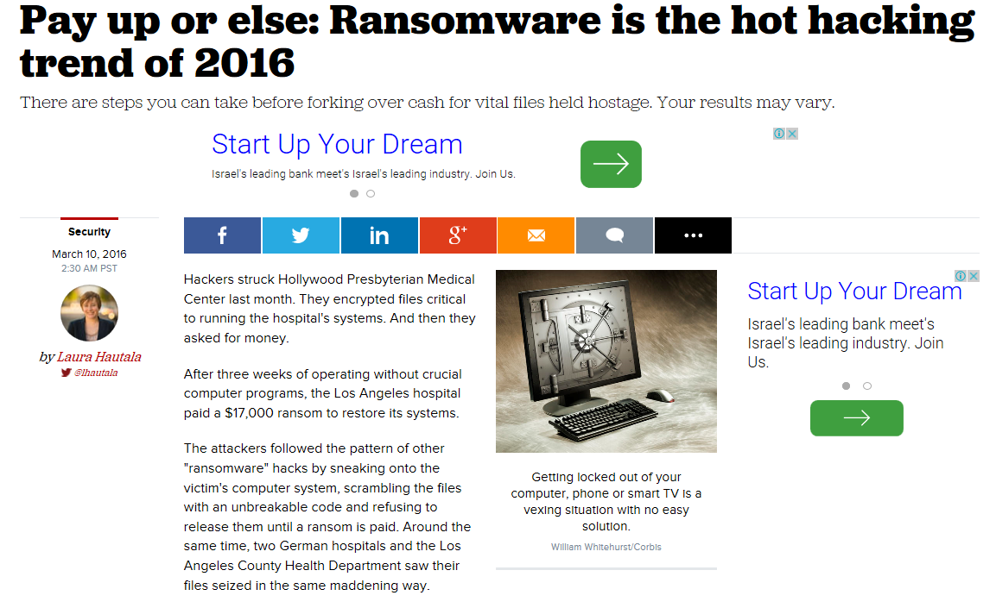
Ransomware

Slide 35
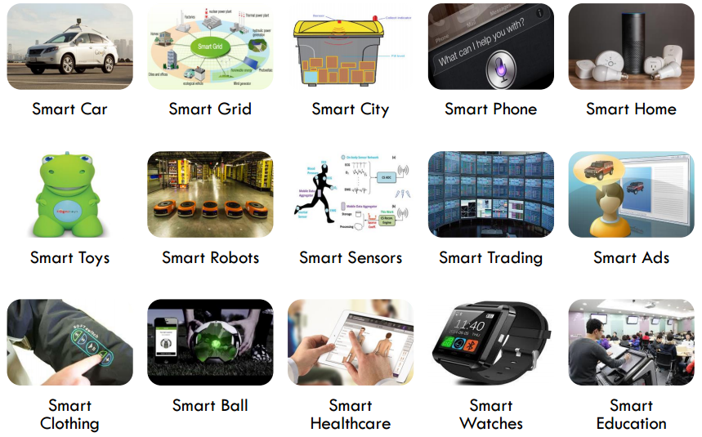
Everything is smart
http://files.meetup.com/20182446/IS_Overview.pdf

Slide 36
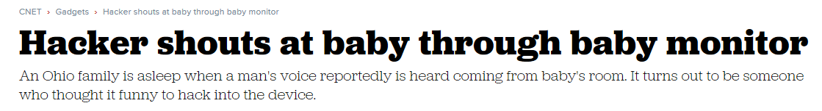
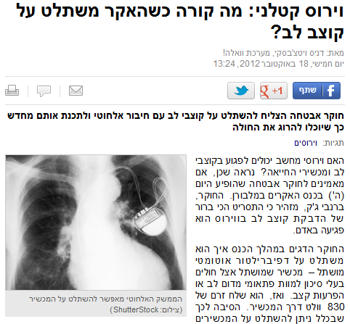
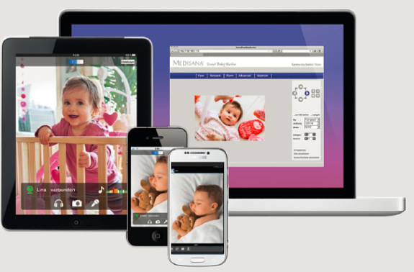
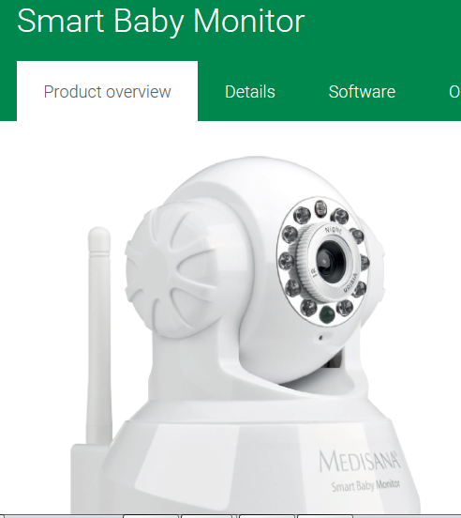
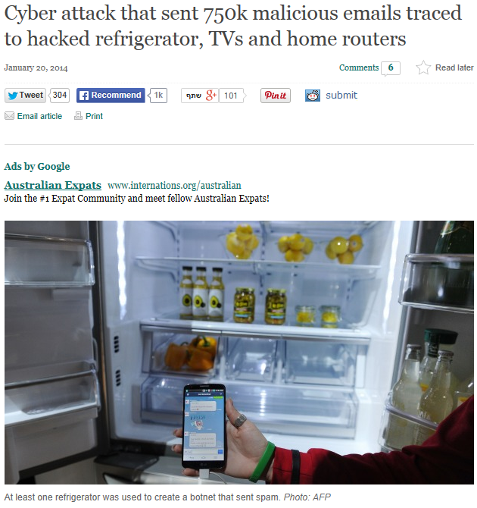
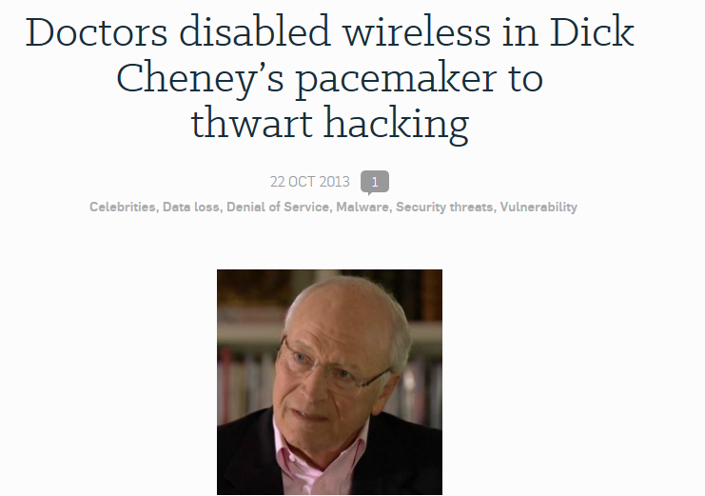
Internet of Things

Slide 37
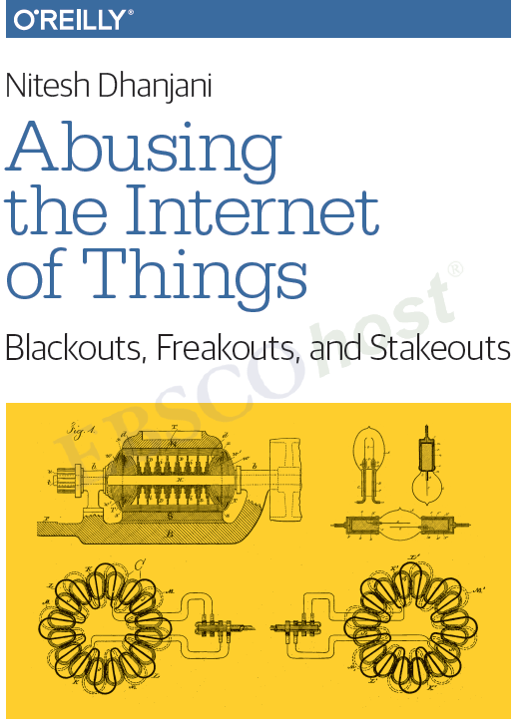
Internet of Things

Slide 38
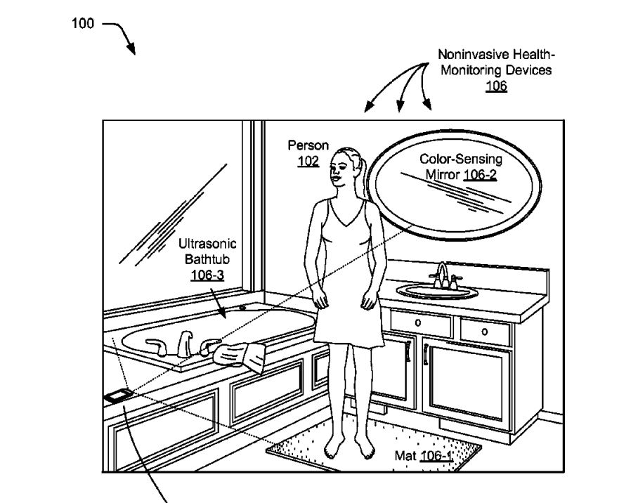
Our future bathroom?
Rug
Electrical measurements through feet
Toilet seat
Measurements of blood pressure and pulse
Mirror
Camera to scan for complexion changes, indicating of blood problems
Speakers in bathtub
Ultrasonic sound waves, for heart-echo and internal organs
http://www.mako.co.il/nexter-news/Article-ed331e883b02651006.htm?sCh=3d385dd2dd5d4110&pId=1758979194_8168

Slide 39

Smart things?

Slide 40
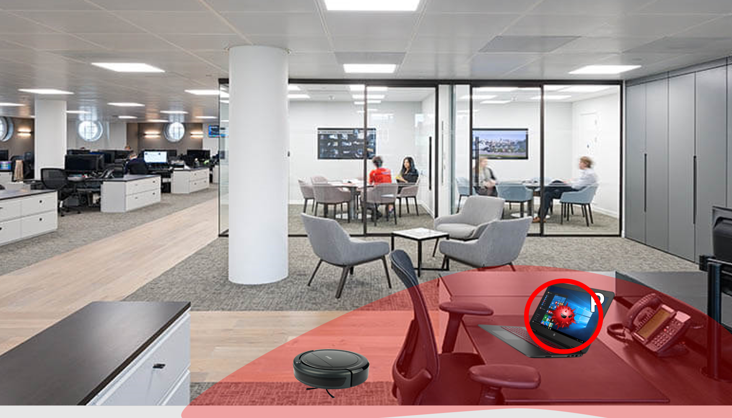
Illustration - iRobot

Slide 41
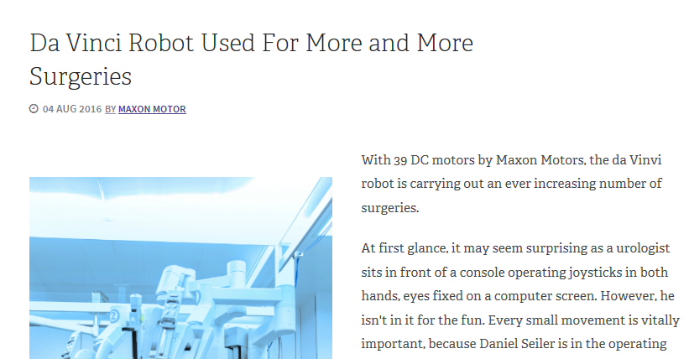
Medical domain…

Slide 42



Smartphones

Slide 43





Some more examples…Data leakage

Slide 44


Sony attack, 2014
Obtained data included personal information about Sony employees, e-mails communication, salaries, copies of (previously) unreleased Sony films, and more

Slide 45

Ashley Madison, 2015

Slide 46

Hacking Team, 2015

Slide 47

T-Mobile US, 2015

Slide 48


Slide 49


Supply-chain attack

Slide 50
Supply-chain attack
"The National Institute of Standards and Technology ("NIST") has recently released a draft update to the Framework for Improving Critical Infrastructure Cybersecurity (also known as the Cybersecurity Framework).
The updated framework provides new details on managing cyber supply chain risks, clarifies key terms, and introduces measurement methods for cybersecurity. In this regard, it aims to further develop NIST’s voluntary guidance to organizations on reducing cybersecurity risks. Several key changes to the Cybersecurity Framework are as follows:
Supply Chain Risk Management: the draft adds cyber supply chain risk management considerations throughout the Cybersecurity Framework, including a new section on “Buying Decisions” and a new category under the Cybersecurity Framework Core’s Identify function with five subcategories;”

Slide 51



After-market devices (WOOT 2018)

Slide 52





After-market devices

Slide 53

IoT Botnets

Slide 54






Slide 55


Bridging the air-gap

Slide 56



Slide 57
Adversarial learning
Due to the large increase in the use of AI methods, hackers concluded that they too should embrace AI
Today, hackers are using machine learning to find loopholes in other machine learning based systems
Fooling AI systems is not very hard as machine learning relies on past cases and assumes that future data shares its characteristics
Hackers abuse this assumption for example, by manipulating the input data

Slide 58

Academic research on AL

Slide 59

Spam detection system
Trained to look for incriminating content by analyzing the text of spam emails
To avoid detection, a spammer can obfuscate the content of an email by deliberately misspelling suspicious words
Notes:
A spam detection system is trained to look for incriminating content by analyzing the text of spam emails. To avoid detection, a spammer can obfuscate the content of an email by deliberately misspelling suspicious words. To the machine, the modified email looks like a non-spam email.

Slide 60

Adversarial traffic signs Robust Physical-World Attacks on Deep Learning Visual Classification
Use Deep Learning (CNN) for image recognition (traffic signs identification) by autonomous vehicles
Adversarial AI can be also applied on machine vision systems
“Confused the computer vision system into thinking that a stop sign was a 45 mph sign, with just a few pieces of tape.”

Slide 61


Handwrite recognition system
If the presented check is examined by a handwriting recognition system, the amount is extracted correctly
However, by adding certain adversarial noise to the digit nine we can fool the system and make it think that it is the digit eight.

Slide 62


Slide 63


Generic Black-Box Attack Against API-Calls Based Malware Classifiers
Ishai Rosenberg, Yuval Elovici, Lior Rokach, Asaf Shabtai

Slide 64

Detecting malware by analyzing system calls
Many of the AI-based anti-viruses examine the sequence of system calls (extracted at runtime) to characterize an application’s behavior
The sequence consists of requests issued by an application towards the operating system
Sequences used as features
Classification based on extracted syscall n-grams
Markov model
ANN – RNNs [Pascanu et al., 2015]; RNN, LSTM, GRU and CNN [Athiwaratkun et al., 2017]; RNN, combining file access and API calls [Wang et al., 2016]; feed-forward DNN, combining static features and API calls [Huang et al., 2016]
…

Slide 65

Classifiers performance
Notes:
DNN - 2 fully connected hidden layers of 128 neurons, each with ReLU activation and dropout rate of 0.2.
CNN - 1D ConvNet with 128 output filters, stride length of 1, 1D convolution window size of 3 and a ReLU activation, followed by a global max pooling 1D layer, followed by a fully connected layer of 128 neurons with ReLU activation and dropout rate of 0.2.
RNN, LSTM, GRU, BRNN, BLSTM, Bidirectional GRU - a hidden layer of 128 units, with dropout rate of 0.2 for both inputs and recurrent states.
Random Forest – 10 DTs, Gini as a picking criteria.

Slide 66

Attack effectiveness
Notes:
The lower the attack effectiveness (previous slide) – the higher the attack overhead (need more iterations and API calls additions to achieve a working adversarial example).

Slide 67


GADGET: Generative Api aDversarial Generic Example by Transferability framework
A framework demonstrating an attacker’s ability to create and end-to-end attack using the proposed method
no-op attack – adding API’s which have no effect on the code’s functionality; with valid parameters
Add the adversarial modifications as an input
The injected code would trace the APIs called so far and each injected API would also call the adversarial added API, if needed
Advantages:
Requires no access to the malware source code
Generic – fit every code
Disadvantages:
API call type-specific
Malware Binary,
without GADGET
Malware Binary, with GADGET

Slide 68
Cyber crime
Any illegal act involving a computer its system or its applications
Computer used as a tool
Computerized device is used as a target
Computer that contain evidences of the crime
New type of crimes
Speed, anonymity, geographical, evidence can be hidden…

Slide 69
Computer & information security
What is computer/information security?
Computer/information security deals with the prevention and detection of unauthorised actions by users of a computer system
Notes:
אבטחת המידע מנקודת ראות מעשית

Slide 70
False assumptions
the code is too complex
why would anyone want to hack me?

Slide 71
Computer & information security
Intrusion detection
Malware detection
Authentication/ verification
Database security
Data leakage detection
Fraud detection
SPAM/Phishing detection
Privacy
Social networks security
Web content filtering
Forensics
Security analytics
Malicious insider detection
Awareness
…
Notes:
אבטחת המידע מנקודת ראות מעשית

Slide 72

Why is it so difficult ?

Slide 73
Why is it so difficult ? Challenges
Deals with abstract threats which cannot be solved only by using mathematical models (encryption/access control)
Protect against whom? employees, business partners, hacker/attacker, customers…
Intentional vs. accidental
Complex systems
Emerging technologies (smart mobile devices, social networks, cloud)
Increasing amounts of data to process
Protecting data while at-rest, in-motion and in-use
Regulations
Competition
Management

Slide 74
Why is it so difficult ? Challenges
Electronic traces everywhere → big data
Identity theft: rather easy (pressure, physical theft, man‐in‐the‐middle)
Eavesdropping
Social engineering
Manipulation (integrity attack)
Internet goes SCADA
Side channel attacks on credit cards, teller machines, printers, smart phones:
Protecting Systems:
Business process risks (e.g. DDoS)
Business intelligence risks (competitor intrudes)
Privacy risks
Externality risks (outside of cyber, e.g. critical infrastructure)

Slide 75

Why is it so difficult ? Challenges
Many types of threats
Wide selection of security tools and vendors (e.g., deployment)
Hard to prove the benefit
Must consider potential attacks
Super users / admin
Requires regular monitoring
Too often an after-thought
Notes:
שום דבר לא קבוע.
מספר הכלים להתמודדות עם המתקפות והאיומים גדל כל הזמן. חלקם של כלים אלו הם בעלי יכולות חופפות/ דומות/ זהות. ניהול של כל אלה ובחירה מתוך חלופות זה נושא אחר.

Slide 76

Security trends
Notes:
In order to assess the relative severity of various threats and the relative importance
of various approaches to computer security, it is useful to look at the experience of
organizations. A useful view is provided by the CSI Computer Crime and Security
Survey for 2010/2011, conducted by the Computer Security Institute. The respondents
consisted of over 350 U.S.-based companies, nonprofit organizations, and
public sector organizations.
Figure 1.4 shows the types of attacks experienced by respondents in nine
major categories. 6 Most noteworthy is the large and growing prevalence of malicious
software (malware) attacks. It is also worth noting that most categories of
attack exhibit a somewhat downward trend. The CSI report speculates that this is
due in large part to improved security techniques by organizations.

Slide 77
And more…
Potential attacks on the security features must be considered (e.g., OpenSSL Heartbleed)
Physical and logical placement needs to be determined
Complex algorithms or protocols may be involved
Attackers only need to find a single weakness, the developer needs to find all weaknesses
Notes:
Computer security is both fascinating and complex. Some of the reasons follow:
1. Computer security is not as simple as it might first appear to the novice. The requirements seem to be straightforward, but the mechanisms used to meet those requirements can be quite complex and subtle.
2. In developing a particular security mechanism or algorithm, one must always consider potential attacks (often unexpected) on those security features.
3. Hence procedures used to provide particular services are often counterintuitive.
4. Having designed various security mechanisms, it is necessary to decide where to use them.
5. Security mechanisms typically involve more than a particular algorithm or protocol, but also require participants to have secret information, leading to issues of creation, distribution, and protection of that secret information.
6. Computer security is essentially a battle of wits between a perpetrator who tries to find holes and the designer or administrator who tries to close them.
7. There is a natural tendency on the part of users and system managers to perceive little benefit from security investment until a security failure occurs.
8. Security requires regular monitoring, difficult in today's short-term environment.
9. Security is still too often an afterthought - incorporated after the design is complete.
10. Many users / security administrators view strong security as an impediment to efficient and user-friendly operation of an information system or use of information.

Slide 78

Security trends

Slide 79

Darknet services or, Malware as a Service

Slide 80


Slide 81
Computer & information security
What is computer/information security?
“Protection afforded to an automated information system in order to attain the applicable objectives of preserving the integrity, availability and confidentiality of information system resources (includes hardware, software, firmware, information/data, and telecommunications).”
[NIST95] The NIST Computer Security Handbook

Slide 82
The AIC triad
Each system\environment\organization can be characterized based on these three factors
Stocks Exchanges systems – will focus more on the availability of the systems
Systems holding medical or customer-related data – will focus more on confidentiality
But is it enough ?
fraud, accountability, authenticity, system does what it was planed\designed to do, privacy, non-repudiation

Slide 83

Concepts and relationships

Slide 84

Terminology

Slide 85

Security taxonomy
Notes:
There is one generally agreed-upon approach used by the CERT and other organizations concerned with computer security, the computer and network security incident taxonomy. Figure 1.4 from the text depicts the overall scope of computer security using this taxonomy. At a top level of detail, an attacker, or group of attackers, achieves their objectives by performing attacks. An incident may be comprised of a single or multiple attacks, as illustrated by the return loop . The key elements are:
• Action: A step taken by a user or process in order to achieve a result
• Target: A computer or network logical entity or physical entity
• Event: An action directed at a target that is intended to result in a change of state, or status, of the target
• Tool: A means of exploiting a computer or network vulnerability
• Vulnerability: A weakness in a system allowing unauthorized action
• Unauthorized result: An unauthorized consequence of an event
• Attack: A series of steps taken by an attacker to achieve an unauthorized result
• Attacker: An individual who attempts one or more attacks in order to achieve an objective
• Objectives: The purpose or end goal of an incident
• Incident: a group of attacks that can be distinguished from other attacks because of the distinctiveness of the attackers, attacks, objectives, sites, and timing

Slide 86
Vulnerabilities, threats and attacks
categories of vulnerabilities
corrupted (loss of integrity)
leaky (loss of confidentiality)
unavailable or very slow (loss of availability)
threats
capable of exploiting vulnerabilities
represent potential security harm to an asset
attacks (threats carried out)
passive – does not affect system resources
active – attempt to alter system resources or affect their operation
insider – initiated by an entity inside the security parameter
outsider – initiated from outside the perimeter
Notes:
In the context of security, our concern is with the vulnerabilities of system
resources. [NRC02] lists the following general categories of vulnerabilities of a
computer system or network asset:
• It can be corrupted , so that it does the wrong thing or gives wrong answers.
For example, stored data values may differ from what they should be because
they have been improperly modified.
• It can become leaky . For example, someone who should not have access to
some or all of the information available through the network obtains such
access.
• It can become unavailable or very slow. That is, using the system or network
becomes impossible or impractical.
These three general types of vulnerability correspond to the concepts of integrity,
confidentiality, and availability, enumerated earlier in this section.
Corresponding to the various types of vulnerabilities to a system resource are
threats that are capable of exploiting those vulnerabilities. A threat represents a
potential security harm to an asset. An attack is a threat that is carried out (threat
action) and, if successful, leads to an undesirable violation of security, or threat
consequence. The agent carrying out the attack is referred to as an attacker, or
threat agent . We can distinguish two types of attacks:
• Active attack: An attempt to alter system resources or affect their operation.
• Passive attack: An attempt to learn or make use of information from the
system that does not affect system resources.
We can also classify attacks based on the origin of the attack:
• Inside attack: Initiated by an entity inside the security perimeter (an “insider”).
The insider is authorized to access system resources but uses them in a way not
approved by those who granted the authorization.
• Outside attack: Initiated from outside the perimeter, by an unauthorized or
illegitimate user of the system (an “outsider”). On the Internet, potential
outside attackers range from amateur pranksters to organized criminals, international
terrorists, and hostile governments.

Slide 87
Threats and consequences
Eavesdropping
Traffic analysis
Masquerading / Spoofing / Identity theft - dark side economy
Man-in-the-Middle (e.g., SSL)
Manipulation of data
Intrusion
Hijacking of hardware (supply chain attack, stealing computer resources)
Botnets (spam, DDoS, spyware, phishing)
Social engineering (phishing, Trojan horse…)
Denial-of-Service
Redirecting traffic destined for one website to another bogus website (browser of victim or DNS server manipulation)
Passive (hard to detect) vs. active attacks
Unauthorized disclosure
Telephony attacks “blue boxing” (or phreaking)
Near‐field, Zigbee etc.
Scada attacks
etc … (will not end and always will come up something new …)

Slide 88

Threats and consequences

Slide 89

Scope of Computer Security
Notes:
The assets of a computer system can be categorized as hardware, software, data,
and communication lines and networks. In this subsection, we briefly describe these
four categories and relate these to the concepts of integrity, confidentiality, and
availability introduced in Section 1.1 (see Figure 1.3 and Table 1.3 ).

Slide 90
Countermeasures
Means used to deals with security attacks
prevent
detect
recover
Goal: minimize risk to an asset
May introduce new vulnerabilities
Residual vulnerability
Notes:
In the context of security, our concern is with the vulnerabilities of system
resources. [NRC02] lists the following general categories of vulnerabilities of a
computer system or network asset:
• It can be corrupted , so that it does the wrong thing or gives wrong answers.
For example, stored data values may differ from what they should be because
they have been improperly modified.
• It can become leaky . For example, someone who should not have access to
some or all of the information available through the network obtains such
access.
• It can become unavailable or very slow. That is, using the system or network
becomes impossible or impractical.
These three general types of vulnerability correspond to the concepts of integrity,
confidentiality, and availability, enumerated earlier in this section.
Corresponding to the various types of vulnerabilities to a system resource are
threats that are capable of exploiting those vulnerabilities. A threat represents a
potential security harm to an asset. An attack is a threat that is carried out (threat
action) and, if successful, leads to an undesirable violation of security, or threat
consequence. The agent carrying out the attack is referred to as an attacker, or
threat agent . We can distinguish two types of attacks:
• Active attack: An attempt to alter system resources or affect their operation.
• Passive attack: An attempt to learn or make use of information from the
system that does not affect system resources.
We can also classify attacks based on the origin of the attack:
• Inside attack: Initiated by an entity inside the security perimeter (an “insider”).
The insider is authorized to access system resources but uses them in a way not
approved by those who granted the authorization.
• Outside attack: Initiated from outside the perimeter, by an unauthorized or
illegitimate user of the system (an “outsider”). On the Internet, potential
outside attackers range from amateur pranksters to organized criminals, international
terrorists, and hostile governments.

Slide 91

Examples of threats
Table 1.3 Computer and Network Assets, with Examples of Threats.
Notes:
HARDWARE A major threat to computer system hardware is the threat to
availability. Hardware is the most vulnerable to attack and the least susceptible to
automated controls. Threats include accidental and deliberate damage to equipment
as well as theft. The proliferation of personal computers and workstations and the
widespread use of LANs increase the potential for losses in this area. Theft of
CD-ROMs and DVDs can lead to loss of confidentiality. Physical and administrative
security measures are needed to deal with these threats.
SOFTWARE Software includes the operating system, utilities, and application
programs. A key threat to software is an attack on availability. Software, especially
application software, is often easy to delete. Software can also be altered or
damaged to render it useless. Careful software configuration management, which
includes making backups of the most recent version of software, can maintain high
availability. A more difficult problem to deal with is software modification that
results in a program that still functions but that behaves differently than before,
which is a threat to integrity/authenticity. Computer viruses and related attacks fall
into this category. A final problem is protection against software piracy. Although
certain countermeasures are available, by and large the problem of unauthorized
copying of software has not been solved.
DATA Hardware and software security are typically concerns of computing center
professionals or individual concerns of personal computer users. A much more
widespread problem is data security, which involves files and other forms of data
controlled by individuals, groups, and business organizations.
Security concerns with respect to data are broad, encompassing availability,
secrecy, and integrity. In the case of availability, the concern is with the destruction
of data files, which can occur either accidentally or maliciously.
The obvious concern with secrecy is the unauthorized reading of data files or
databases, and this area has been the subject of perhaps more research and effort
than any other area of computer security. A less obvious threat to secrecy involves
the analysis of data and manifests itself in the use of so-called statistical databases,
which provide summary or aggregate information. Presumably, the existence of
aggregate information does not threaten the privacy of the individuals involved.
However, as the use of statistical databases grows, there is an increasing potential
for disclosure of personal information. In essence, characteristics of constituent
individuals may be identified through careful analysis. For example, if one table
records the aggregate of the incomes of respondents A, B, C, and D and another
records the aggregate of the incomes of A, B, C, D, and E, the difference between
the two aggregates would be the income of E. This problem is exacerbated by the
increasing desire to combine data sets. In many cases, matching several sets of data
for consistency at different levels of aggregation requires access to individual units.
Thus, the individual units, which are the subject of privacy concerns, are available at
various stages in the processing of data sets.
Finally, data integrity is a major concern in most installations. Modifications
to data files can have consequences ranging from minor to disastrous.

Slide 92
Passive and Active Attacks
Passive attacks attempt to learn or make use of information from the system but does not affect system resources
eavesdropping/monitoring transmissions
difficult to detect
emphasis is on prevention rather than detection
two types:
release of message contents
traffic analysis
Active attacks involve modification of the data stream
goal is to detect them and then recover
four categories:
masquerade
replay
modification of messages
denial of service
Notes:
COMMUNICATION LINES AND NETWORKS
Network security attacks can be classified
as passive attacks and active attacks . A passive attack attempts to learn or make
use of information from the system but does not affect system resources. An active
attack attempts to alter system resources or affect their operation.
Passive attacks are in the nature of eavesdropping on, or monitoring of,
transmissions. The goal of the attacker is to obtain information that is being transmitted.
Two types of passive attacks are release of message contents and traffic
analysis.
The release of message contents is easily understood. A telephone conversation,
an electronic mail message, and a transferred file may contain sensitive or
confidential information. We would like to prevent an opponent from learning the
contents of these transmissions.
A second type of passive attack, traffic analysis , is subtler. Suppose that we
had a way of masking the contents of messages or other information traffic so that
opponents, even if they captured the message, could not extract the information
from the message. The common technique for masking contents is encryption. If we
had encryption protection in place, an opponent might still be able to observe the
pattern of these messages. The opponent could determine the location and identity
of communicating hosts and could observe the frequency and length of messages
being exchanged. This information might be useful in guessing the nature of the
communication that was taking place.
Passive attacks are very difficult to detect because they do not involve any
alteration of the data. Typically, the message traffic is sent and received in an
apparently normal fashion and neither the sender nor receiver is aware that a
third party has read the messages or observed the traffic pattern. However, it is
feasible to prevent the success of these attacks, usually by means of encryption.
Thus, the emphasis in dealing with passive attacks is on prevention rather than
detection.
Active attacks involve some modification of the data stream or the creation
of a false stream and can be subdivided into four categories: replay, masquerade,
modification of messages, and denial of service.
Replay involves the passive capture of a data unit and its subsequent retransmission
to produce an unauthorized effect.
A masquerade takes place when one entity pretends to be a different entity. A
masquerade attack usually includes one of the other forms of active attack. For example,
authentication sequences can be captured and replayed after a valid authentication
sequence has taken place, thus enabling an authorized entity with few privileges
to obtain extra privileges by impersonating an entity that has those privileges.
Modification of messages simply means that some portion of a legitimate
message is altered, or that messages are delayed or reordered, to produce an
unauthorized effect. For example, a message stating, “Allow John Smith to read
confidential file accounts” is modified to say, “Allow Fred Brown to read confidential
file accounts.”
The denial of service prevents or inhibits the normal use or management of
communications facilities. This attack may have a specific target; for example, an
entity may suppress all messages directed to a particular destination (e.g., the security
audit service). Another form of service denial is the disruption of an entire network,
either by disabling the network or by overloading it with messages so as to degrade
performance.
Active attacks present the opposite characteristics of passive attacks. Whereas
passive attacks are difficult to detect, measures are available to prevent their
success. On the other hand, it is quite difficult to prevent active attacks absolutely,
because to do so would require physical protection of all communications facilities
and paths at all times. Instead, the goal is to detect them and to recover from any
disruption or delays caused by them. Because the detection has a deterrent effect, it
may also contribute to prevention.

Slide 93
Who are the bad guys?
Elite hackers
Virus writers and releasers
Script kiddies: limited but numerous
Criminals - growing rapidly
Employees, Consultants, and Contractors
White hats: use their hacking ability for defensive purpose
Ethical hacker: former black hat, white hat, consulting company; using his skills for defensive purposes
Cyberterrorism and Cyberwar
Hacktivism: hacking for a cause (e.g., social or political agenda)
Virtual gangs: a group of hackers that each one of them specializes in different platform

Slide 94
Goals of information security
Identification of the organization’s assets
Making sure that important assets (data\information, hardware, software, network) of the organization are protected
Allowing the organization to run its business with as less disruptions as possible
Continuous and iterative activity of integrating, implementing, improving and validating security mechanisms to allow running business process
Complying with information security policies, rules, regulations

Slide 95
Computer security strategy – how do we get it done?
Specification/policy
what is the security scheme supposed to do?
consider the value of the assets; vulnerabilities; potential threats and the likelihood of attacks
“Ease of use versus security”
“Cost of security versus cost of failure and recovery”
Risk management
Implementation/mechanisms
how does it do it?
prevention, detection, response, recovery
Correctness/assurance
does it really work?
assurance, evaluation

Slide 96
Security plan elements
Governance
Policy
Asset identification & classification
Risk management program
Intelligence program
Audit & compliance program
Incident management
Education & awareness program
Technical security (systems, communication)
Access control
Identification and Authentication
Configuration management
Contingency planning
Monitoring
Physical security
Employees/personnel
Forensics

Slide 97
ת"י 7799 – ניהול אבטחת מידע
1. קביעת מדיניות אבטחת מידע
2. ארגון אבטחת מידע
3. סיווג ובקרה של נכסי הארגון
4. אבטחת עובדים
5. אבטחה פיזית וסביבתית
6. ניהול תקשורת ותפעול
7. בקרת גישה
8. פיתוח ותחזוקה של מערכות
9. ניהול המשכיות עסקית
10.תאימות

Slide 98

Security technologies used
Implementing mature, low cost solutions

Slide 99

Key drivers
Client requirement
Legal, regulations
Potential exposure
Common practice
Security vs. privacy
Budget
Transparency

Slide 100
Who is responsible for security
Executive management\CEO ?
IT department\CTO ?
IT security stuff ?
Everyone! – all employees and stakeholders of the organization

Slide 101
Who is responsible for security
IT department and CTO
Security function in the IT department
Independent unit reporting to the management managed by the CISO

Slide 102
Role of security in today’s world
Top management
Endorse and lead information security
Chief Information Security Officer (CISO)
Responsible for the design and implementation of a comprehensive security plan
Information security implementer
Implement, install, support , maintain security tools
The “hands-on” function
Sometime the network administrator is also the IS implementer
Deep understanding in Windows, Linux, databases, network security and also in specific products (Symantec, Cisco …)
Notes:
מנהל אבטחת מידע ארגוני (CISO) אחראי על גיבושה ומימושה של תוכנית אבטחת המידע שמטרתה להבטיח שנכסי המידע הארגוניים מוגנים כנדרש. במסגרת זו, מנהל אבטחת המידע אחראי על זיהוי, ניתוח וניהול של סיכוני אבטחת מידע באופן העונה על דרישות העסק והרגולציה. התפקיד מצריך חזון ומנהיגות בשילוב יכולות טובות בתחום הניהול הטכנולוגי והעסקי. ה-CISO פועל ביחד עם הגורמים העסקיים בארגון לצורך גיבוש מדיניות וסטנדרטים של אבטחת מידע. הוא גם מפקח על כלל פעילויות ניהול הסיכונים ב-IT.
ה-CISO משמש כאחראי על כלל התהליכים והפעילויות הכרוכים בשמירה על זמינות, כלילות (integrity) וחשאיות המידע של העסק, של לקוחותיו, של שותפיו העסקיים ושל עובדיו. כל זאת בהתאם למדיניות אבטחת המידע הארגונית. גורם מפתח בתפקידו של ה-CISO טמון ביכולתו לעבוד עם ההנהלה הבכירה בארגון בכדי להגדיר, במשותף, את רמות הסיכון המקובלות על העסק. מנהל אבטחת המידע חייב להיות בעל ידע רחב בסביבה העסקית וחייב לוודא שמערכות המידע מנוהלות ופועלות באופן מאובטח.
באופן אידיאלי, מנהל אבטחת המידע משמש כמתווך בין אנשים ותהליכים, מנהיג בעל מחשבה ויכולת לפתרון בעיות, יועץ אפקטיבי, בעל יכולות רחבות בתחום אבטחת המידע ובעל ניסיון של 8-10 שנים בניהול ואבטחת מידע.
תחומי אחריות
פיתוח, יישום וניטור של תוכנית מקיפה ופרטנית לאבטחת המידע וניהול סיכונים בהיבטי זמניות, כלילות וחשאיות המידע הארגוני.
ניהול גוף האבטחה של הארגון, במתווי דיווח ישירים ועקיפים, לרבות גיוס, אימון, פיתוח והערכת ביצועי עובדים.
פיתוח, תקשור ווידוא של מימוש מדינות ונוהלי אבטחת המידע של הארגון.
גיבוש וניהול תקציבי אבטחת מידע.
יצירה וניהול של תוכנית מודעות והדרכת אבטחת מידע לכלל עובדי הארגון, ספקים חיצוניים ומשתמשי המערכות.
עבודה מול היחידות העסקיות השונות בכדי לנתח סיכוני אבטחת מידע, לזהות רמות מקובלות של סיכון ולמסד תפקידים ותחומי אחריות בתחום סיווג והגנה על המידע.
לספק ייעוץ להנהלה הבכירה במגוון רחב של סטנדרטים ופרקטיקות מקובלות בתחום אבטחת המידע.
לספק הנחיה טקטית ואסטרטגית בתחום אבטחת המידע לפרויקטי IT, לרבות הערכה והמלצה על שילוב בקרות טכניות.
תיאום מול גופי התכנון ב-IT במטרה לוודא ששיקולי אבטחת מידע נלקחים בחשבון באסטרטגיית הבניה והתשתית של מערכות המידע בארגון.
תיאום פרויקטים של אבטחה וניהול סיכונים מול גוף ה-IT והגורמים העסקיים הרלבנטיים.
ווידוא קיום דרישות החוק, הרגולציה והמדיניות הנוגעים לאבטחת מידע.
תיאום וקישור בין גוף האבטחה לגופי הממשל התאגידי, הביקורת, כוח האדם, היועצים המשפטיים וכיו"ב.
יצירה וניהול של תהליך הערכת סיכוני אבטחת מידע, לרבות דיווח ופיקוח על הפעולות המתקנות כתוצאה מזיהוי מפגעי אבטחה.
ניהול אירועי אבטחת מידע.
תיאום השימוש במשאבים חיצוניים הקשורים בתוכנית האבטחה, לרבות ניהול מו"מ, גיבוש הסכמים ותנאי עסקות לאספקת שירותים או מוצרים בתחום אבטחת מידע.
פיתוח מדיניות אפקטיבית להתאוששות מאסון, תיאום של יצירת תוכניות ונוהלי התאוששות, בכדי להבטיח המשכיות עסקית במקרה של אסון.
פיתוח מדדים רלבנטיים להערכת היעילות והאפקטיביות של תוכנית האבטחה, בכדי לוודא הקצאה נכונה של משאבים ופיתוח הבשלות של התוכנית.
התאמה של האבטחה לצרכי העסק ויצירת תקשורת עם ההנהלה באמצעות יצירת צוות היגוי בכיר לאבטחת מידע.

Slide 103
Role of security in today’s world
Information security architect\engineer
Design the security solution that should protect the organization against its risks
Instruct the IS implementers
Information security auditor
Auditing of security products, processes, policies etc.
Penetration tester\Ethical Hacker
Hacking to systems and assets
Detecting vulnerabilities
Forensics investigator

Slide 104
Designing a security system
What goals do we want to achieve?
Does the system focus on the data, operations or the users of the system?
What level should the security system operate from? Should it be at the level of hardware, operating system or applications package?
Should it be simple or sophisticated?
In a distributed system, should the security be centralized or spread?
How do you secure the levels below the level of the security system?

Slide 105
Types of security controls and solutions
Physical measures: CCTV, guard, fences, locks, CD-ROM\USB removal, fire alarms, controlling individual access to the facility…
Administrative measures: developing and publishing policies, standards, procedures and guidelines, screening and background checks, awareness, risk assessment, audit, training…
Technical (logical) measures: access control mechanisms to systems, passwords, firewalls, anti-virus, IDS, VPNs, configuration managements, backup…

Slide 106
Categories
 | Administrative | Technical | Physical
Directive | Policy | Warning/ instructive banner | Security guard
Deterrent | Demotion | Audit logs | Security guard
Preventive | Information classification | Encryption / access control | Fences
Detective | Investigation | IDS | Motion detectors
Corrective | Termination | Anti-virus | Fire extinguisher
Recovery | DRP | Backups | Rebuild
Compensating | Supervision | Keystroke dynamic | Layered fences

Slide 107
Security services
Authentication
assuring that a communication is from the source that it claims to be from
must assure that the connection is not interfered with by a third party masquerading as one of the two legitimate parties
Data origin authentication
Access control
the ability to limit and control the access to host systems and applications via communications links

Slide 108
Security services
Nonrepudiation
prevents either sender or receiver from denying a transmitted message
receiver can prove that the alleged sender in fact sent the message
the sender can prove that the alleged receiver in fact received the message

Slide 109
Security services
Data confidentiality
the protection of transmitted data from passive attacks
protects the traffic flow from analysis
this requires that an attacker not be able to observe the source and destination, frequency, length, or other characteristics of the traffic on a communications facility

Slide 110
Security services
Data Integrity
can apply to a stream of messages, a single message, or selected fields within a message
protection against message modification only
assures that messages are received as sent, with no duplication, insertion modification, reordering, or replays
destruction of data is also covered under this service
Availability
a service that protects a system to ensure its availability

Slide 111
Assurance and Evaluation
assurance
the degree of confidence one has that the security measures work as intended to protect the system and the information it processes
encompasses both system design and system implementation
evaluation
process of examining a computer product or system with respect to certain criteria
involves testing and formal analytic or mathematical techniques
Notes:
Those who are “consumers” of computer security services and mechanisms (e.g.,
system managers, vendors, customers, and end users) desire a belief that the security
measures in place work as intended. That is, security consumers want to feel that the
security infrastructure of their systems meet security requirements and enforce security
policies. These considerations bring us to the concepts of assurance and evaluation.
The NIST Computer Security Handbook [NIST95] defines assurance as the
degree of confidence one has that the security measures, both technical and operational,
work as intended to protect the system and the information it processes. This
encompasses both system design and system implementation. Thus, assurance deals
with the questions, “Does the security system design meet its requirements?” and
“Does the security system implementation meet its specifications?”
Note that assurance is expressed as a degree of confidence, not in terms of a formal
proof that a design or implementation is correct. With the present state of the art,
it is very difficult if not impossible to move beyond a degree of confidence to absolute
proof. Much work has been done in developing formal models that define requirements
and characterize designs and implementations, together with logical and mathematical
techniques for addressing these issues. But assurance is still a matter of degree.
Evaluation is the process of examining a computer product or system with
respect to certain criteria. Evaluation involves testing and may also involve formal
analytic or mathematical techniques. The central thrust of work in this area is
the development of evaluation criteria that can be applied to any security system
(encompassing security services and mechanisms) and that are broadly supported
for making product comparisons.

Slide 112
Social engineering
Human are usually the weakest link in the security chain
Social engineering is the human side of breaking into a corporate network
Acquisition of sensitive information or inappropriate access privileges by an outsider based upon inappropriate trust relationships with insiders
The goal is to cone the victim into providing valuable information

Slide 113





80%-95% of the attacks exploits human vulnerabilities

Slide 114

Social engineering
Human are usually the weakest link in the security chain
Social engineering is the human side of breaking into a corporate network
Acquisition of sensitive information or inappropriate access privileges by an outsider based upon inappropriate trust relationships with insiders
The goal is to cone the victim into providing valuable information
Steps
Information gathering
Development of relationship
Exploiting of relationship
Execution to achieve objective

Slide 115
Social engineering - types
Human-based - person-to-person interaction in order to retrieve the desired information
Impersonation
Posing as important user
Third party authorization
Masquerading
Dumpster Diving (= Trashing) and shoulder surfing
Computer-based
Having computer software that attempts to retrieve desired information
Mail or Instant Messaging (IM) attachments
Pop up windows
Websites
Spam mail
CD / DVD/ USB …

Slide 116


Checkpoint analysis of Gooligan: 1m Google accounts compromised (30/11/16)
The malware code been found in dozens of legitimate-looking apps on third-party app stores which offer free versions of paid application
Gooligan-infected apps are also installed using phishing scams
After Gooligan is installed he collect data about the device and downloads a rootkit that takes advantage of well-known Android 4 and 5 (old versions) exploits
These exploits still plague many devices today because the patches were never installed by the user

Slide 117
Information security An on going process
Prevention
Monitoring and detection
Response
Emergency – carry out BCP
Recovery
Forensics \ investigation
Updating
Auditing,
Periodic testing

